Slide 1
Brief intro to axes
Programming for Data Analytics
Andrew.Beatty@ATU.ie

Slide 2
Functions to create AXES
Subplots()
Subplot_mosaic()
SubFigure()

Slide 3
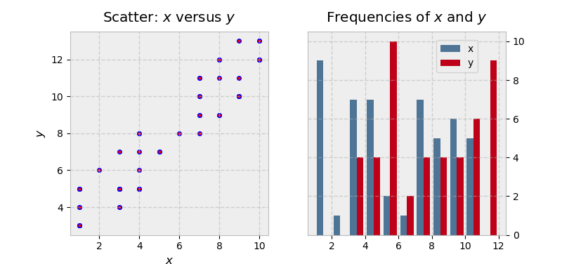
Multiple plots on one figure
x = np.random.randint(low=1, high=11, size=50)
y = x + np.random.randint(1, 5, size=x.size)
data = np.column_stack((x, y))
fig, (ax1, ax2) = plt.subplots(nrows=1, ncols=2,
figsize=(8, 4))
ax1.scatter(x=x, y=y, marker='o', c='r', edgecolor='b')
ax1.set_title('Scatter: $x$ versus $y$')
ax1.set_xlabel('$x$')
ax1.set_ylabel('$y$')
ax2.hist(data, bins=np.arange(data.min(), data.max()),
label=('x', 'y'))
ax2.legend(loc=(0.65, 0.8))
ax2.set_title('Frequencies of $x$ and $y$')
ax2.yaxis.tick_right()

Slide 4
That’s enough for now

